Slide 1
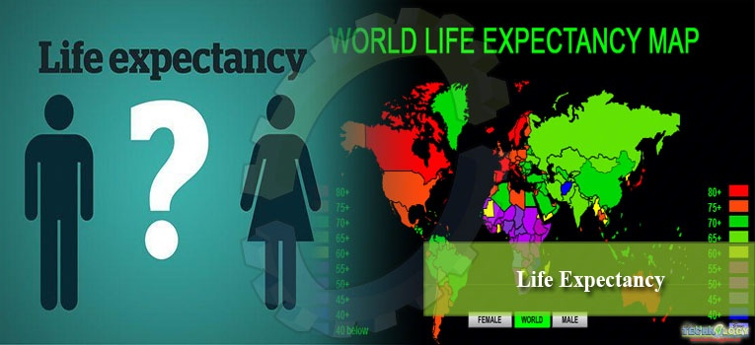
Life expectancy
.Abhishek
.Prince
.Shubham
.Ashutosh
By:BRIGHT FUTURE

Slide 2

Problem statement
“Investing in health and
promoting it throughout the life span is the only way to ensure that
more people will reach old age in good health and capable of contributing to society, intellectually, spiritually and physically”

Slide 3

Introduction
This project is about estimating the age of the people from the data given by who from data from 2000 to 2015
The following algorithms have been used to predict the life expectancy of a newly given input in watson studio.
1.Linear Regression
2.Multiple Regression
3.Decision Tree Regression
4.Random Forest Regression
Testing the data on all the above model and taking the one with highest efficiency to predict the model.

Slide 4
Methodology :
Data reading
Data preprocessing
Exploratory data analysis
Learning
Regression
Prediction
Conclusion
References

Slide 5

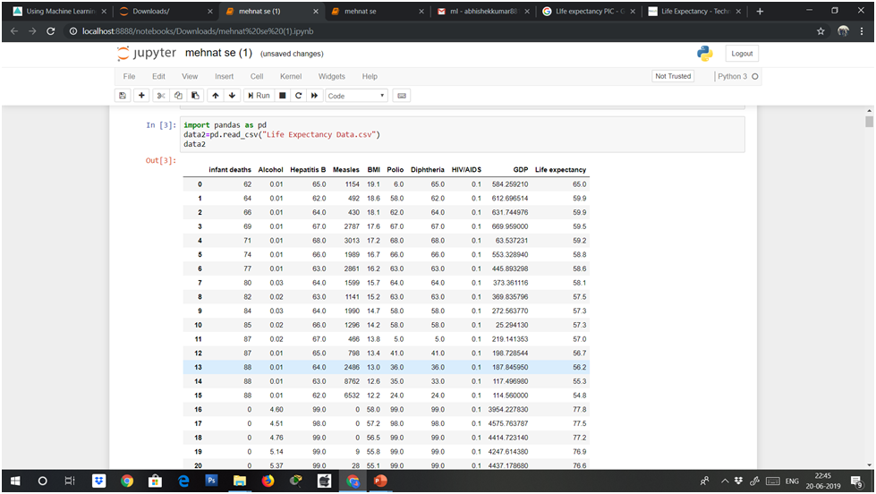
Data reading : Reading the csv file using pandas

Slide 6
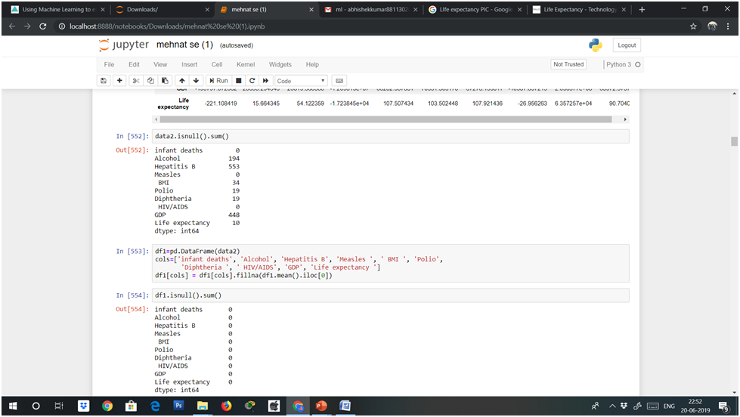
Data preprocessing : Checking the null values in the data set

Slide 7
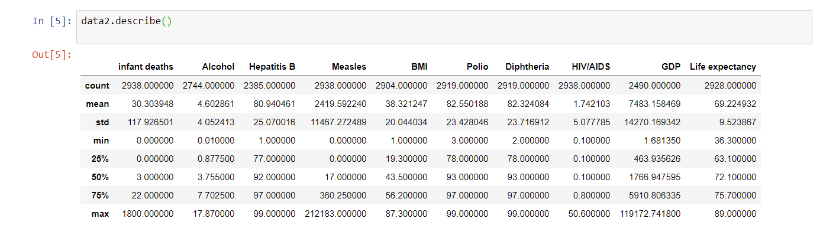
Exploratory Data Analysis : Description about the features of dataset

Slide 8
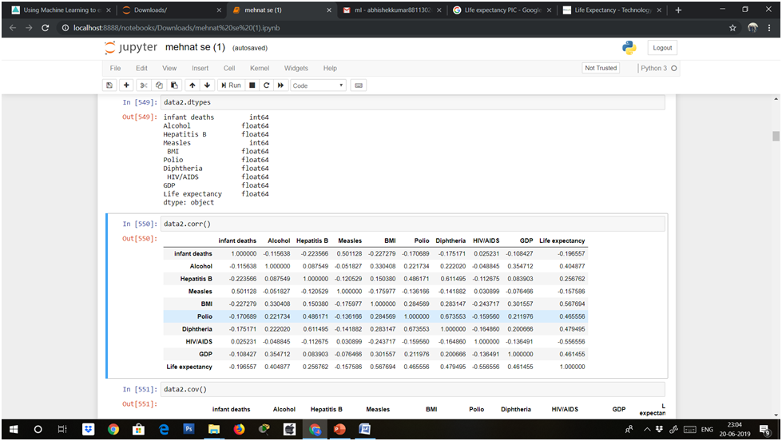
Correlation : It gives the relationship between the features and the labels.

Slide 9
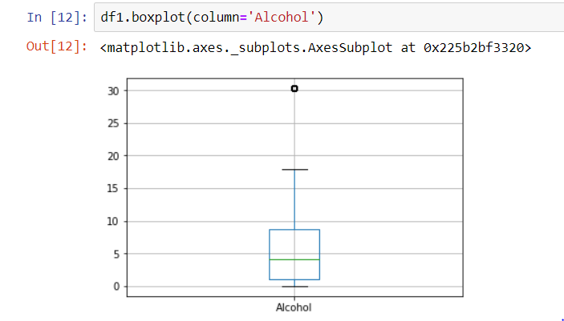
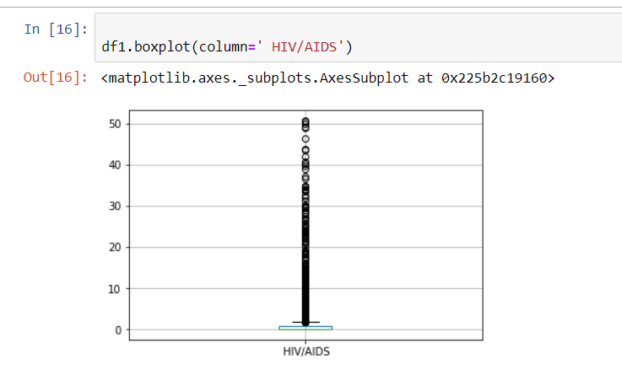
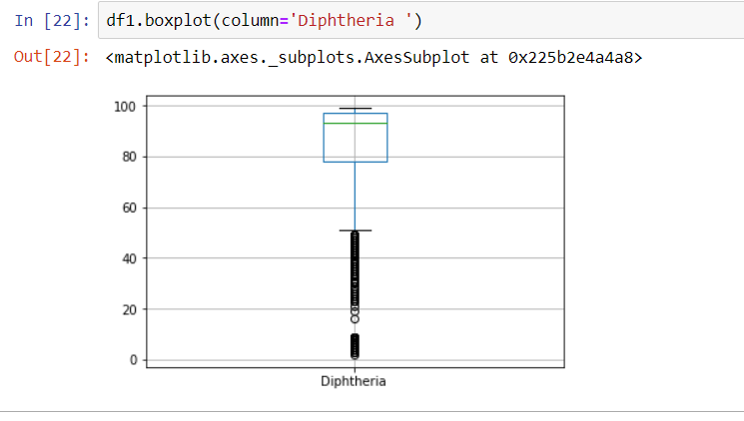
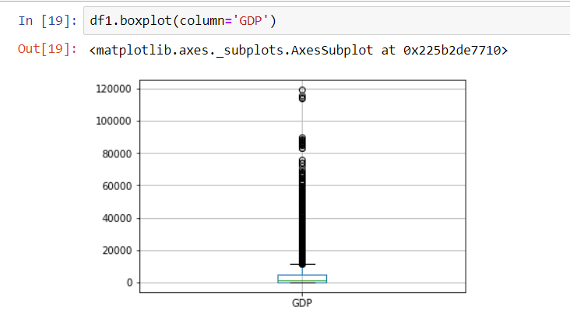
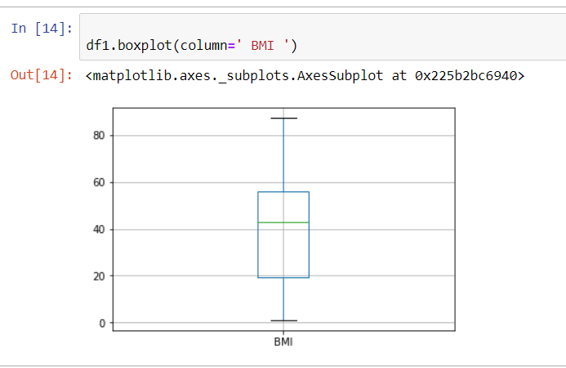
Box plot : A simple way of representing statistical data on a plot in which a rectangle is drawn to represent the second and third quartiles ,usually with a vertical line inside to indicate the median values.

Slide 10

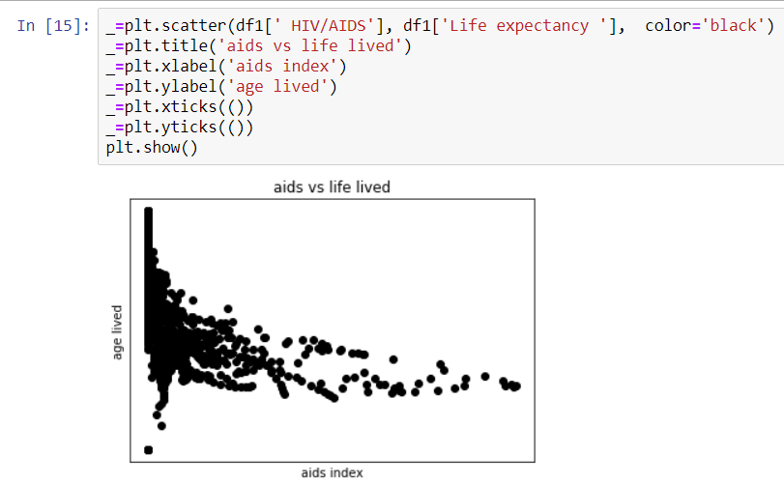
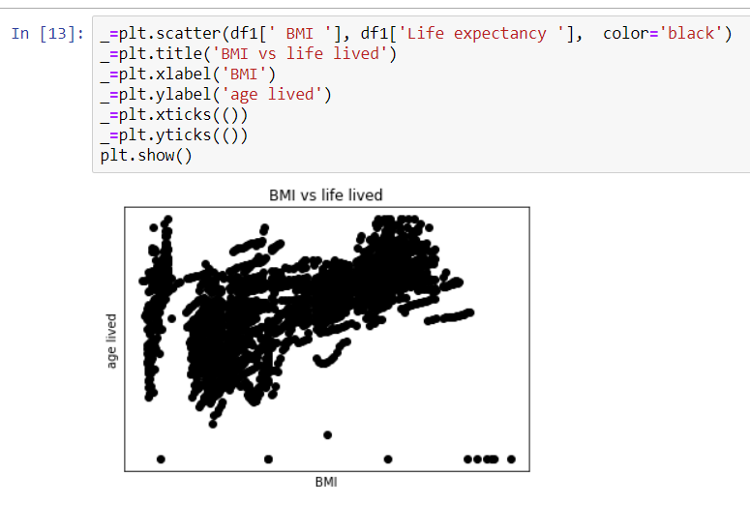
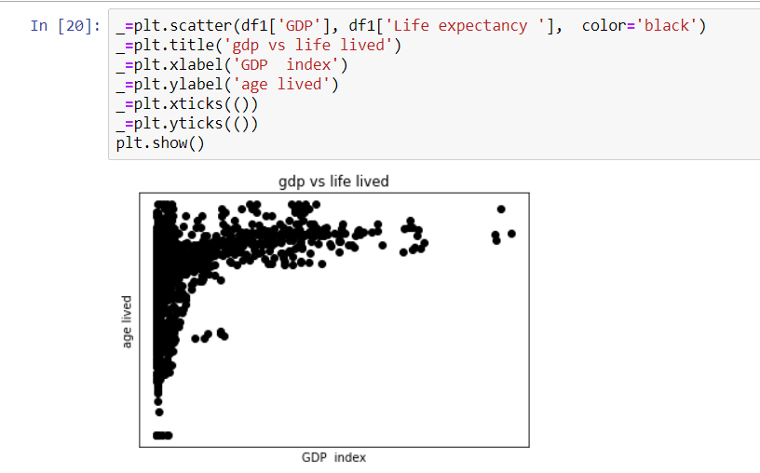
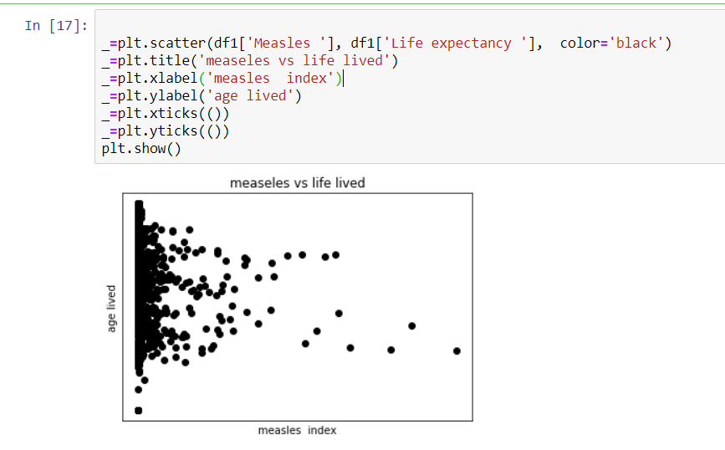
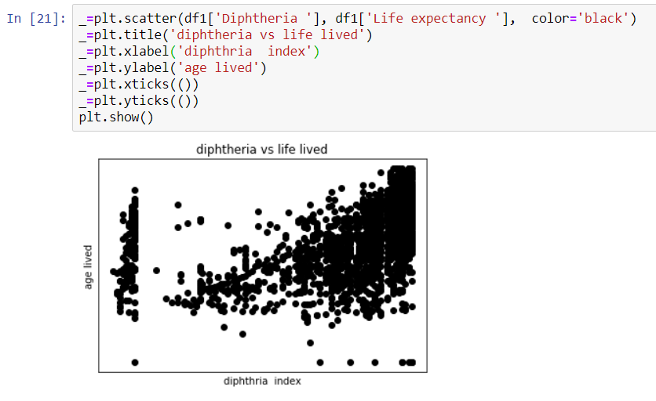
Scatter plot
:
Histograms :
Histograms :
Histograms :
Histograms :

Slide 11
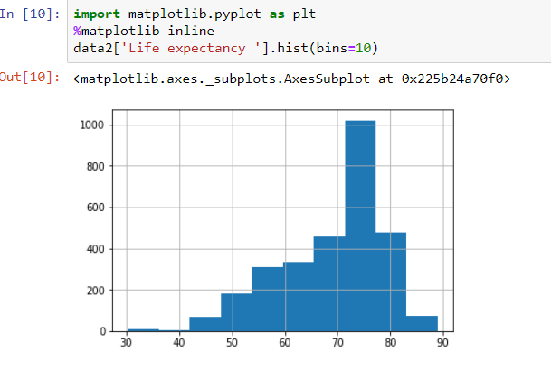
Histograms : It is an accurate representation of the distribution of numerical data.

Slide 12
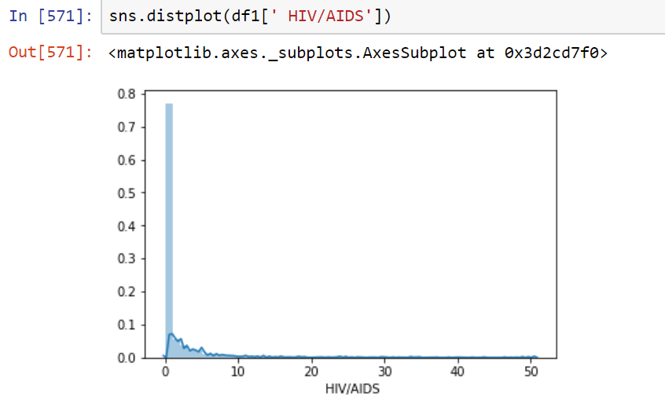
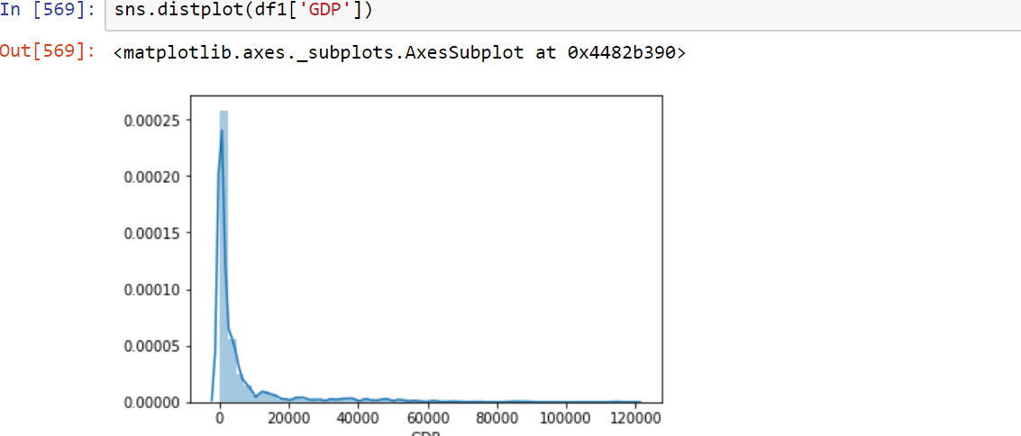
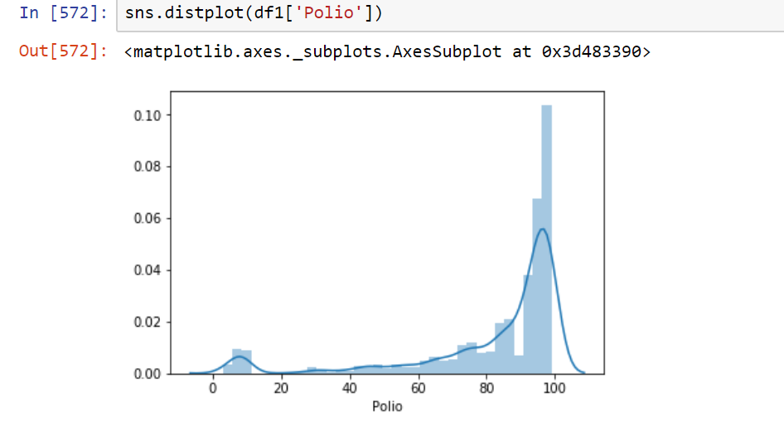
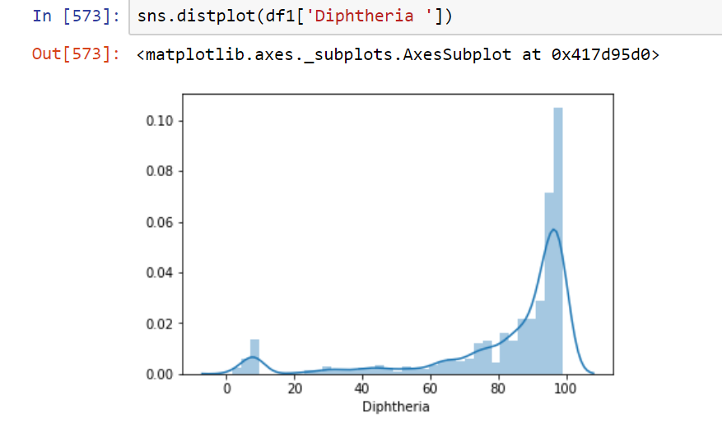
Distplots : These are used to check how the data is distributed.

Slide 13
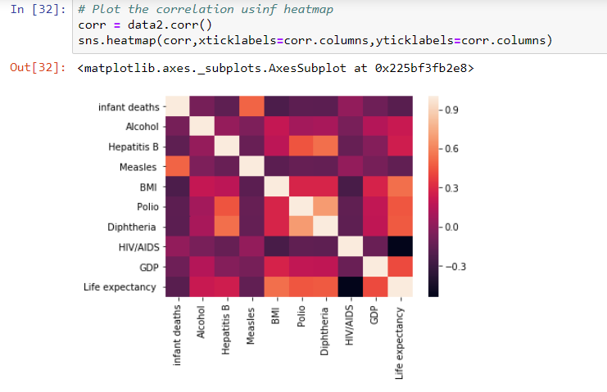
Heat map : A representation of data in the form of a map or diagram in which data values are represented as colors.

Slide 14
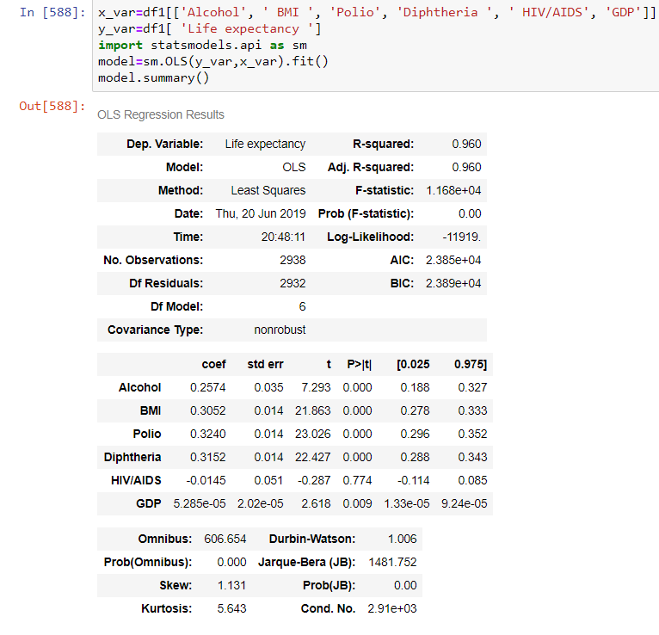
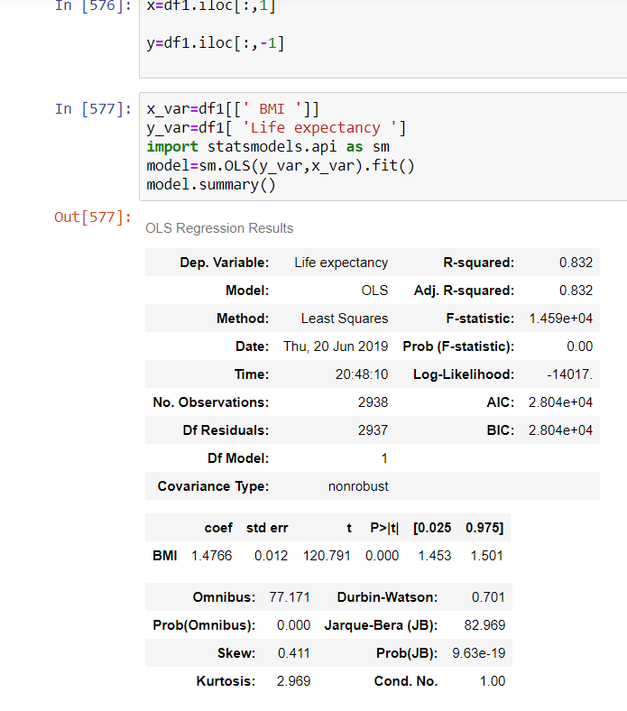
Stats model : It is a python package that allows users to explore data, estimate statistical models , and perform statistical tests.

Slide 15
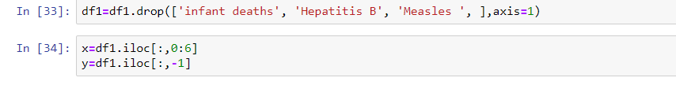
Learning :
There are two phases:
Training
Testing
Training: In this phase the data from the dataset will get trained.
Testing: With the help of the test data the output can be predicted.

Slide 16
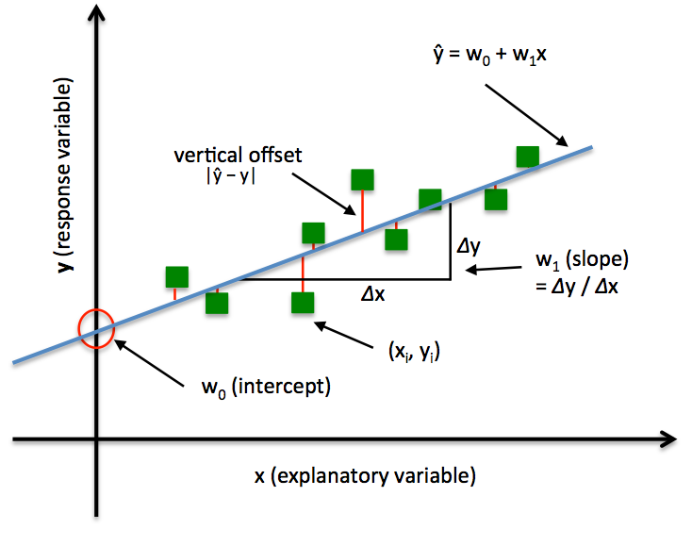

LINEAR REGRESSION
.
Linear regerssion is used when we try to predict to predict the output of a dependent from an independent variable.
Linear regression is used when both the dependent and independent variables are numerical in nature.
Linear regression does not always gaurentee high accuracy
Better for small models having low no of columns.
The mathematical formula used for linear regression is y=m x + c where y is output , m is the slope and c is the intercept of the line on the y axis.

Slide 17
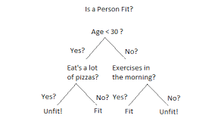
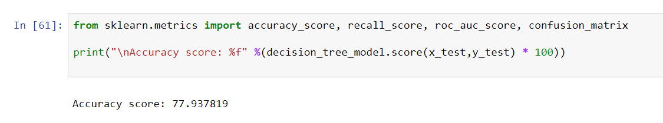
Decision Tree Regression:
A decision tree is a decision support tool that uses a tree-like graph or model of decisions and their possible consequences, including chance event outcomes, resource costs, and utility. It is one way to display an algorithm that only contains conditional control statements.
Lower the entropy better is the classification for the model.

Slide 18
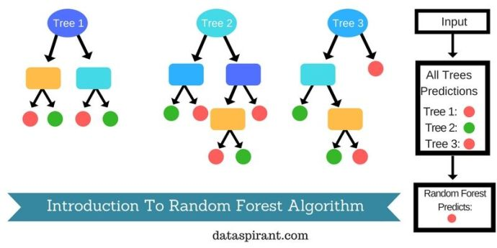
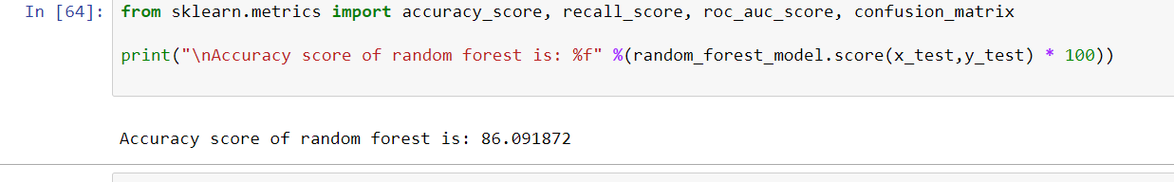
Random Forest Regression:
Random forests or random decision forests are an ensemble learning method for classification, regression and other tasks that operates by constructing a multitude of decision trees at training time and outputting the class that is the mode of the classes (classification) or mean prediction (regression) of the individual trees.
Random decision forests correct for decision trees' habit of over fitting to their training set.

Slide 19
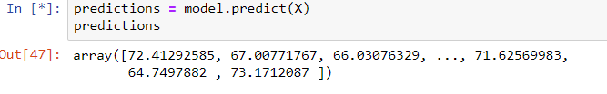
Prediction: The predicted values of the new data.

Slide 20
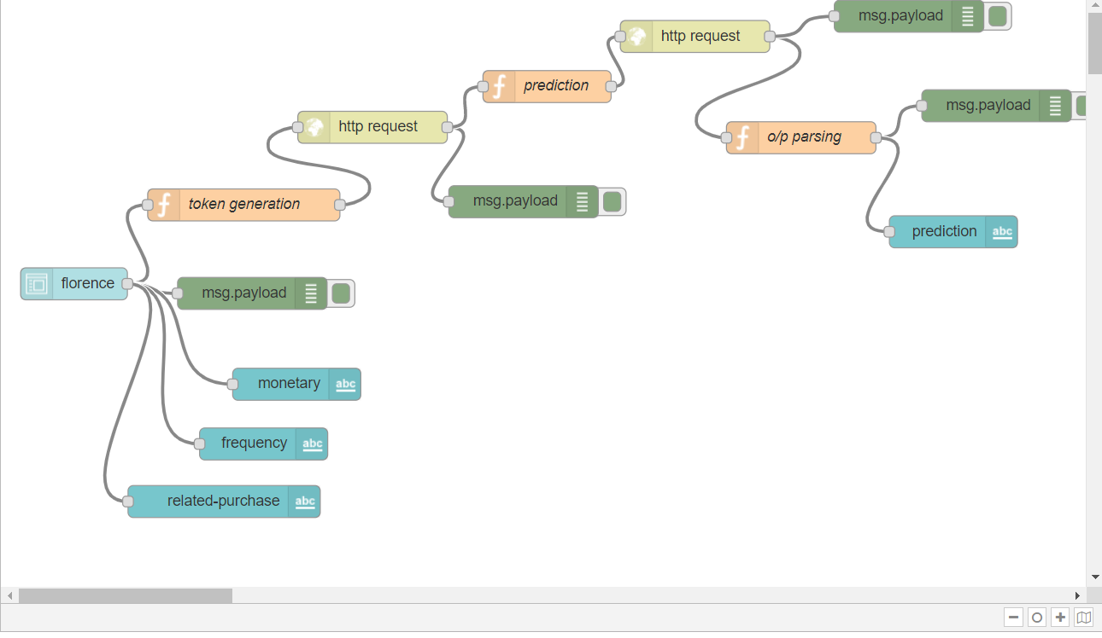
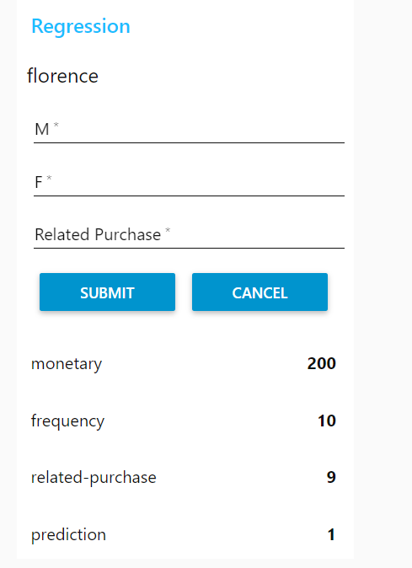
Node-red:

Slide 21
Conclusion
Hereby , we conclude that Random Forest Regression best fits for this problem statement.
The accuracy of classification for this model is higher when compared to the other models.

Slide 22

References:
www.google.com
www.wikepedia.com
https://www.geeksforgeeks.org/
http://www.tutorialspoint.com/

Slide 23

thankyou

